Slide 1
Understanding Migrant Deaths and Survivors: A Decade of Data

Slide 2
Introduction
Migration has been an enduring global phenomenon, but it often comes with tragic consequences. This story delves into the data from 2014 to 2023, focusing on migration trends in the Americas and the Caribbean. It examines patterns in migrant deaths and survivors, causes of death, and seasonal variations, shedding light on critical events and offering insights into trends and anomalies.

Slide 3
Methodology
The data comes from the Missing Migrants Project dataset, updated until the end of 2023.
Key transformations included filtering for regions of interest (Caribbean, Central America, North America, and South America) and excluding incomplete or irrelevant entries (e.g., data from 2024).
All visualizations were created using R and Tableau, leveraging interactivity and statistical summaries.

Slide 4
Section 1: Temporal Trends in Migrant Deaths and Missing

Slide 5
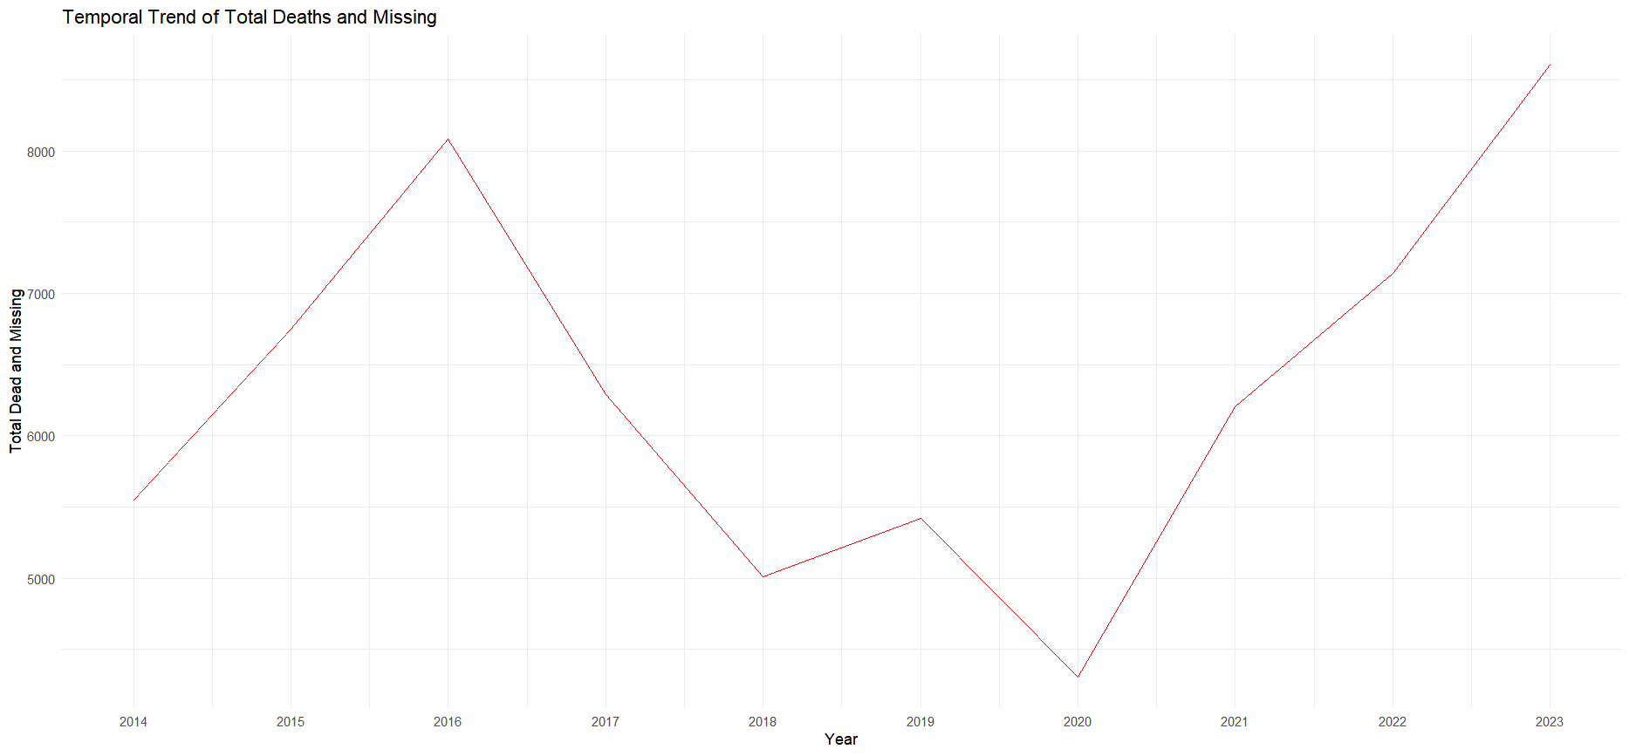

Slide 6
Chart 1: Temporal Trend of Total Deaths and Missing
This line graph shows a steady decline in deaths from 2015 to 2018, followed by a resurgence in 2022 and 2023.
Key Insight: The peak in 2015 correlates with increased migration attempts during the U.S. border crisis, while the resurgence aligns with recent geopolitical instability in the region.

Slide 7
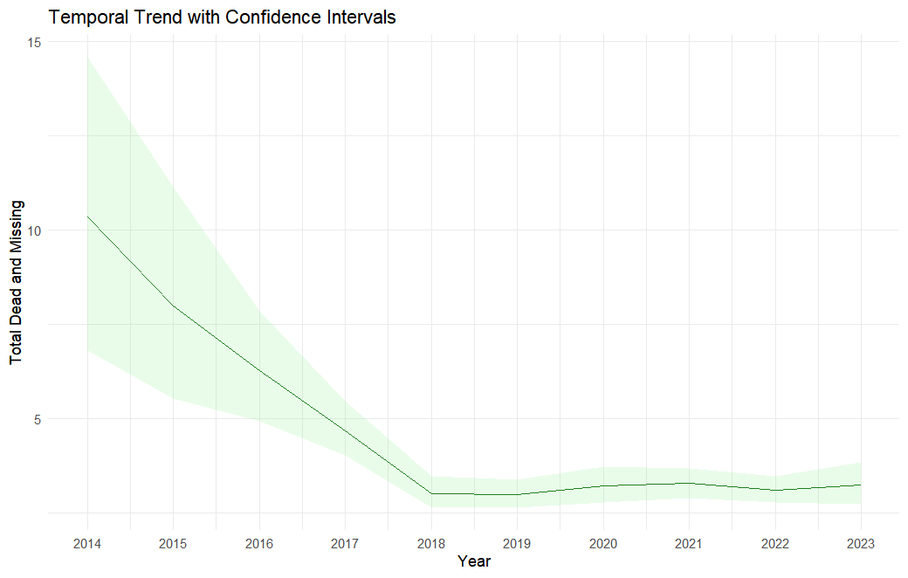

Slide 8
Chart 2: Temporal Trend with Confidence Intervals
Highlights variability and confidence in death data over the years.
Key Insight: Uncertainty was highest in earlier years, potentially due to limited reporting mechanisms.

Slide 9
Section 2: Exploring Causes of Death

Slide 10
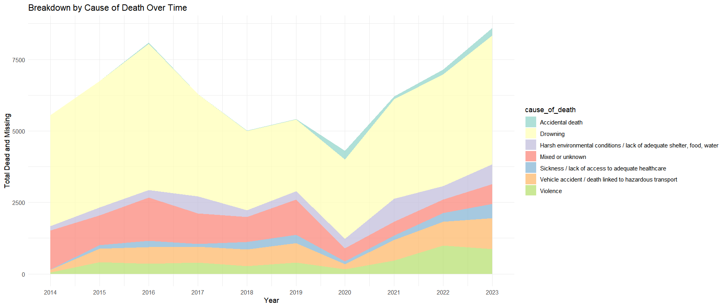

Slide 11
Chart 3: Breakdown by Cause of Death Over Time
Stacked area chart categorizing deaths by cause.
Key Insight: Drowning consistently accounts for the majority of deaths, particularly in 2015 and 2023. Harsh environmental conditions also show a marked increase in recent years.

Slide 12
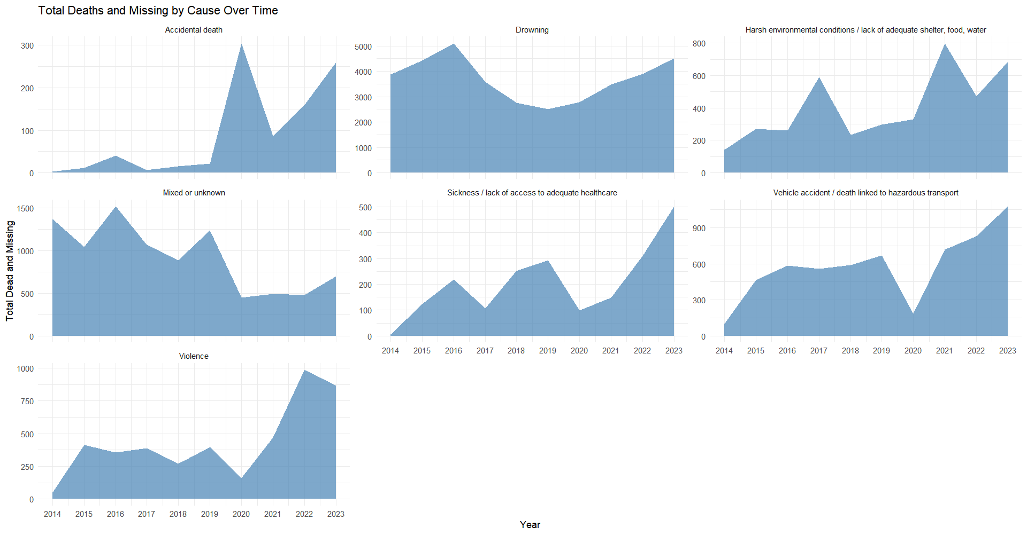

Slide 13
Chart 4: Total Deaths and Missing by Cause Over Time
Faceted area charts focus on each cause of death.
Key Insight: Violence and vehicle-related deaths peaked in 2022, reflecting changing migration routes and dangers.

Slide 14
Section 3: Comparing Deaths vs Survivors

Slide 15
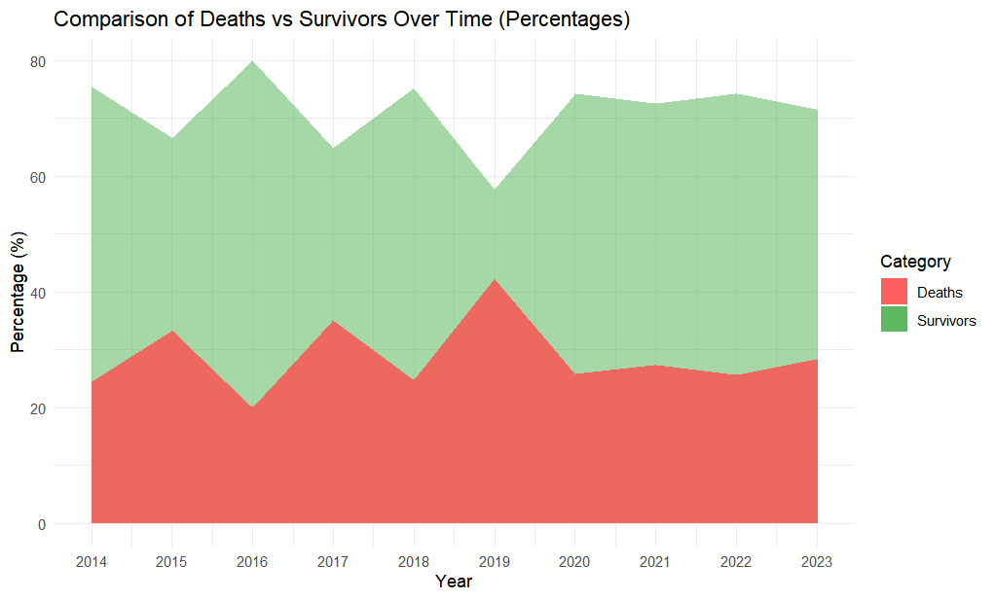

Slide 16
Chart 5: Comparison of Deaths vs Survivors Over Time (Percentages)
Survivors have consistently outnumbered deaths, but the gap narrowed significantly in 2015, 2017, and 2019.
Key Insight: The narrowing in 2015 highlights the high fatality rate during the U.S.-Mexico migration crisis.
Historical Context: Research shows a correlation between these years and restrictive migration policies, such as the "Remain in Mexico" program.

Slide 17
The years 2015, 2017, and 2019 witnessed significant migration events and policy changes in the Americas and the Caribbean, which likely influenced the observed spikes in migrant deaths and disappearances during these periods.
2015: Escalation of Migration from Central America
In 2015, there was a notable increase in migration from Central American countries, particularly from the Northern Triangle—El Salvador, Guatemala, and Honduras—toward the United States. This surge was driven by escalating violence, political instability, and economic hardship in these countries. Migrants faced perilous journeys, often encountering dangerous terrain and exploitation by smugglers, leading to increased fatalities.

Slide 18
2017: Venezuelan Migration Crisis
The political and economic crisis in Venezuela intensified around 2017, resulting in a mass exodus of Venezuelans seeking refuge in neighboring countries such as Colombia, Brazil, and others in the Caribbean. The sudden influx strained resources and infrastructure in host countries, leading to precarious living conditions for migrants. Many undertook hazardous routes, including treacherous sea crossings, contributing to a rise in deaths and disappearances.
2019: Stricter U.S. Immigration Policies and Increased Migration
In 2019, the United States implemented stricter immigration policies, including the "Remain in Mexico" program, which required asylum seekers to wait in Mexico while their claims were processed. This policy led to overcrowded and unsafe conditions in border areas, prompting some migrants to attempt more dangerous crossings. Additionally, the ongoing crises in countries like Venezuela and Nicaragua continued to drive people toward perilous migration routes, resulting in higher mortality rates.
These events underscore the complex interplay between political decisions, economic conditions, and migration patterns, which collectively impact the safety and survival of migrants in the regio

Slide 19
References:
2015: Escalation of Migration from Central America
UNHCR (2015). Women on the Run: First-hand accounts of refugees fleeing El Salvador, Guatemala, Honduras, and Mexico.
International Crisis Group (2015). Central America’s Violent Northern Triangle.
2017: Venezuelan Migration Crisis
UNHCR (2017). Venezuelans on the move: A growing crisis.
Migration Policy Institute (2017). Venezuelan Migrants in Latin America and the Caribbean. Link
2019: Stricter U.S. Immigration Policies and Increased Migration
Human Rights Watch (2019). US: ‘Remain in Mexico’ Program Threatens Asylum Seekers.
Migration Policy Institute (2019). Crisis at the Border? Not by the Numbers.
Washington Post (2019). Trump administration's Remain in Mexico policy explained. Link

Slide 20
Section 4: Monthly and Route-Based Patterns

Slide 21
Chart 6: Monthly Patterns (Tableau)
Visualizes deaths by month across all years.
Key Insight: Peaks occur during summer months, coinciding with dangerous migration attempts across deserts and seas.

Slide 22
Chart 7: Trends by Migration Route (Tableau)
Explores deaths by route over time.
Key Insight: The Central America route saw the highest fatalities, highlighting the perils faced by migrants traveling northward.

Slide 23
Section 5: Averages and Anomalies

Slide 24
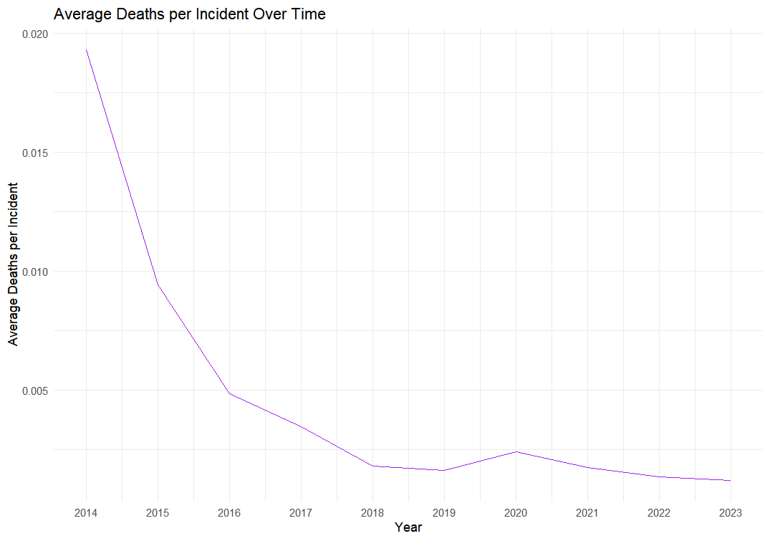

Slide 25
Chart 8: Average Deaths per Incident Over Time
A clear decline in average deaths per incident is observed.
Key Insight: Improved search and rescue operations may explain this trend.

Slide 26
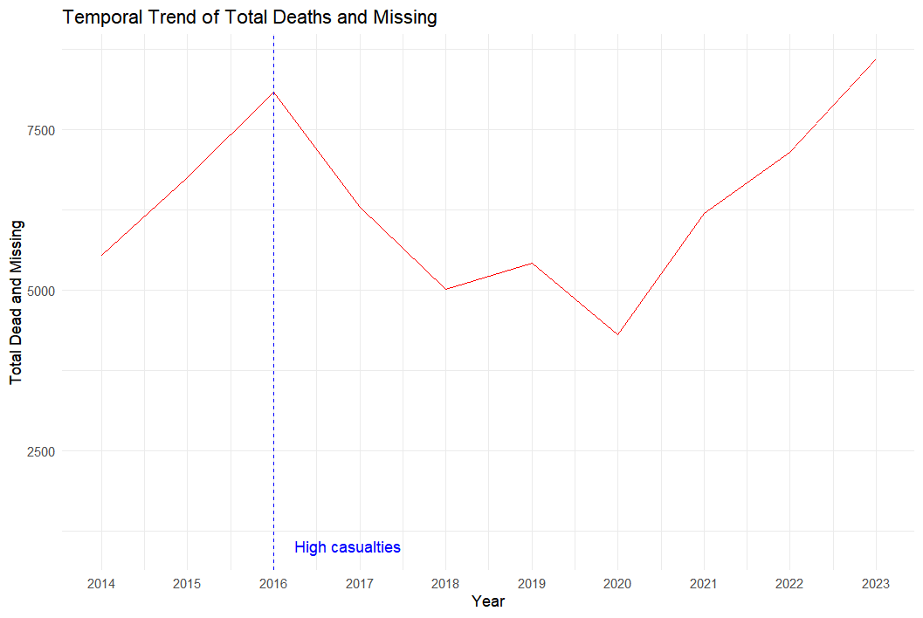

Slide 27
Chart 9: Temporal Trend of Total Deaths with High Casualties
Annotates 2015 with the “High Casualties” label.
Key Insight: This underscores the disproportionate death toll during the U.S. migration crisis.

Slide 28
Section 6: Insights and Recommendations

Slide 29
Insights:
Peak Years (2015, 2017, 2019): These years reflect significant geopolitical and policy-driven migration challenges.
Seasonality: Summer months are the deadliest, requiring targeted interventions.
Drowning and Violence: These remain the most critical causes of death, indicating the need for safer routes and rescue operations.

Slide 30
Recommendations:
Policy Adjustments: Governments must focus on humanitarian corridors during peak months.
Improved Data Collection: Enhanced monitoring and reporting mechanisms will fill gaps and reduce uncertainties.
Route-Specific Solutions: Focus on Central America and the Caribbean with targeted interventions like rescue patrols and safer passage agreements.

Slide 31
Conclusion
This analysis highlights the tragic cost of migration and the need for coordinated global responses to reduce fatalities. Data stories like this not only inform policy decisions but also ensure that the lives lost are not forgotten.

